Slide 1



ULTRApreneur Program Overview
The ULTRApreneur Program is a comprehensive health optimization system designed specifically for entrepreneurs and high performers, offering science-based testing and personalized strategies to enhance energy, longevity, and overall performance over 3, 6, or 12 months.

Slide 2

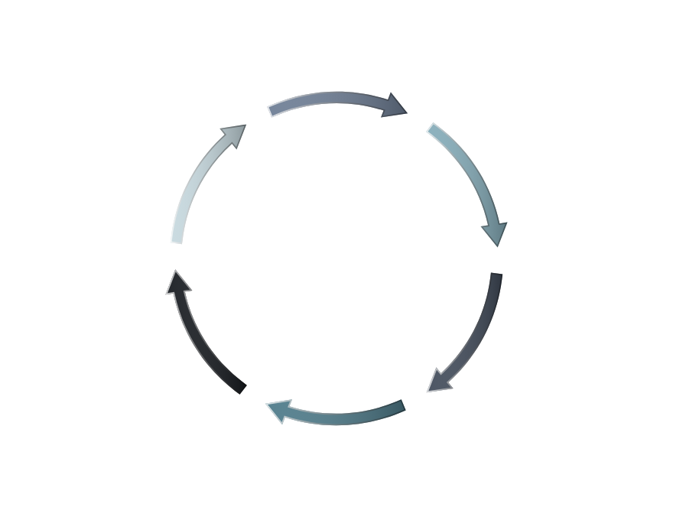
Why ULTRApreneur Stands Out in Anti-Aging
Discover a personalized roadmap to slow aging effectively.
Address Root Causes
Key Health Metrics
Control Your Aging
Personalized Plans
Real System for Health
Regular Retesting

Slide 3






Personalized Health Plan
Optimizing health for entrepreneurs in a structured way
Initial Results Analysis
Custom Workout Plan
Sleep Optimization Protocol
We examine data from the initial weeks to drive our personalized plan. This sets a targeted approach.
A tailored workout regimen focusing on Resistance Training, Zone 2, and Zone 5 for optimal results.
Implementing strategies to enhance sleep quality, which is crucial for recovery and overall health.
Nutritional Guidance
Targeted Supplementation
Long-term Goals
Providing personalized dietary advice to ensure clients are fueled for their specific goals and activities.
Identifying necessary supplements to address any deficiencies and enhance performance and recovery.
Setting a foundation for sustained health adaptation and monitoring progress over time to ensure success.
www.ultrapreneurgroup.com

Slide 4

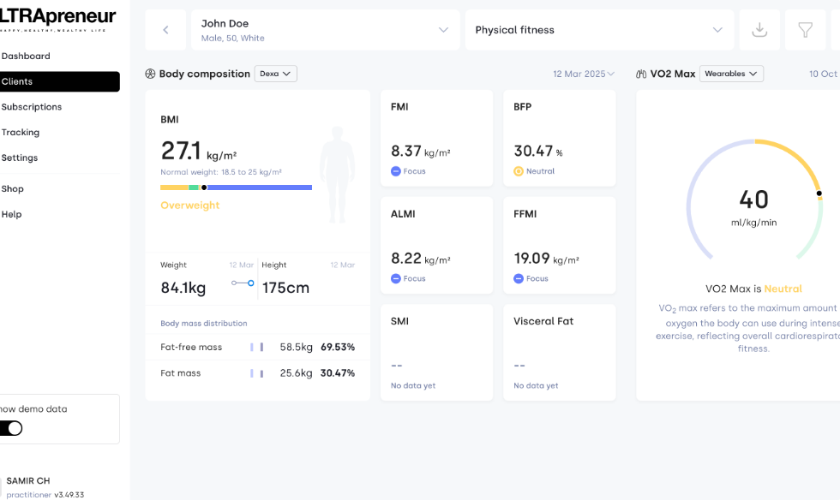
ULTRApreneur Program Structure
An Overview of Key Phases for Health Optimization
Phase 1: Initial Testing
Access the ULTRApreneur app for onboarding and complete baseline testing to evaluate health metrics.
Comprehensive Assessments
Testing includes VO2 Max, Body Composition, RHR Tracking, Functional Strength & Balance and a Comprehensive Blood Test.
Outcome Measurement
Results lead to calculating Biological Age and creating a personalized Health KPI Dashboard.
www.ultrapreneurgroup.com

Slide 5

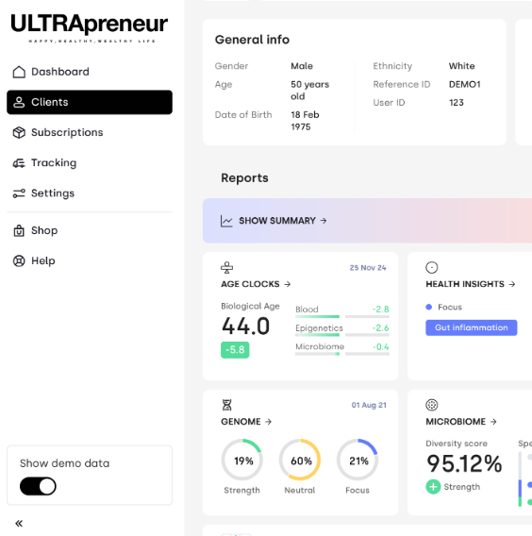






Retesting & Optimization
Key Steps for Continued Success
Re-measure Health KPIs
Regularly assess key health indicators every 6-8 weeks to gauge progress.
Focus on Metrics
Include VO2 Max, body composition, HRV, RHR, functional strength, and biological age.
Compare and Optimize
Analyze metrics to compare progress, refine plans, and ensure continuous improvement.
www.ultrapreneurgroup.com

Slide 6
Implementation & Coaching
Key Phases for Optimal Health
Begin daily tracking of workouts, HR, habits, and recovery via app.
Daily App Tracking
Start
Weekly Check-ins
Initiate implementation and coaching processes aimed at maximizing performance.
Conduct weekly or bi-weekly check-ins with your coach for progress assessment.
www.ultrapreneurgroup.com

Slide 7
Implementation & Coaching
Key Phases for Optimal Health
Focus on structured habit formation to maintain long-term health benefits.
Structured Habit Formation
Completion of Coaching
Wrap up coaching phase with a review of performance metrics and recovery protocols.
www.ultrapreneurgroup.com

Slide 8


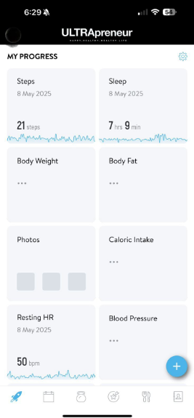






Mastery & Long-Term Adaptation
Elevate your health with strategic focus
Deep Cardiovascular Adaptation
Peak Longevity Strategies
Enhancing cardiovascular health to improve overall vitality and endurance, vital for sustained performance.
Implementing practices and habits that promote long-term health and reduce the risk of age related diseases.
Muscular Adaptation Support
Building strength and flexibility through tailored workouts that promote resilience and longevity in fitness.
Leadership-Level Energy
Cultivating mental clarity and physical energy to maintain focus and drive in entrepreneurial pursuits.
Metabolic Flexibility
Enhancing the body's ability to efficiently use different energy sources for improved metabolic health.
www.ultrapreneurgroup.com

Slide 9

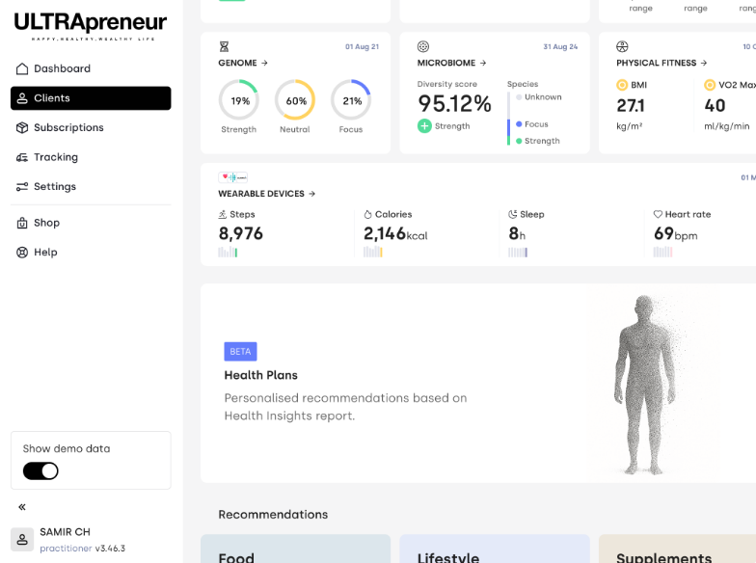
ULTRApreneur App Features
Overview of Key Functionalities
01
Custom Dashboard & Charts
04
Private Coaching Access
The app features a customizable dashboard to visualize user progress through various metrics.
The app grants users access to private coaching for personalized support and guidance.
02
Personalized Health Metrics
05
Members-Only Community
Users receive tailored health metrics that help track their wellness journey effectively.
Users can connect with a community of members for support, motivation, and sharing experiences.
03
Daily Tasks and Protocols
Users can manage daily tasks and health protocols to ensure consistent progress.
www.ultrapreneurgroup.com

Slide 10




ULTRApreneur vs Traditional Fitness Solutions
Traditional Fitness Approaches
ULTRApreneur Approach
1.
We build systems instead of selling products
1.
Sell products, supplements, and trends
2.
Treat your body like a business with measurable KPIs
2.
Offer generic workouts and hacks without testing
3.
Slow aging with proven methods
3.
Provide no system, no tracking, and no proof
4.
Track and improve biological markers for better health
4.
Focus on motivation without data

Slide 11


Aging = Decline in key biological markers. We reverse that.
We focus on reversing the decline in key biological markers associated with aging.

Slide 12
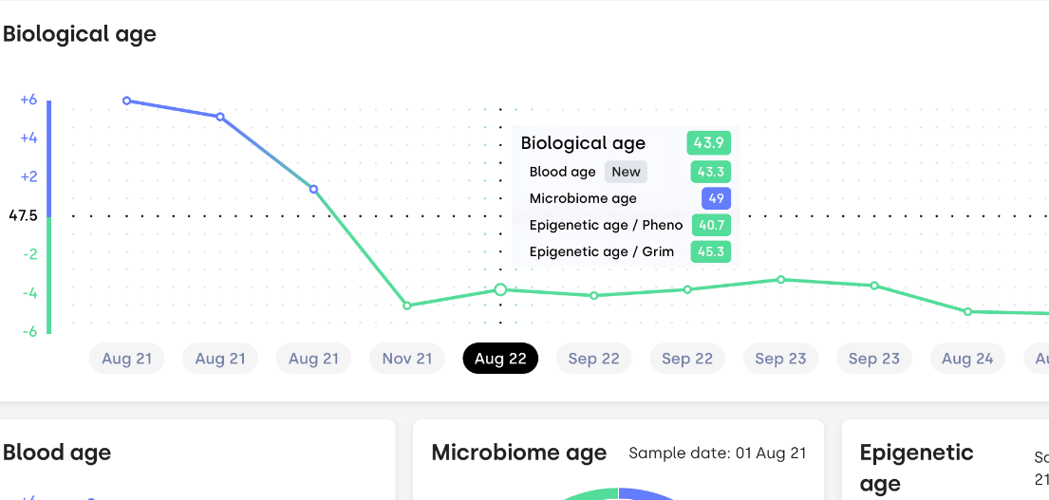
Biological Age = measurable → We test and prove it’s decreasing.
✔️ If your metrics improve, your biological age decreases. ✔️ If your biological age drops, your productivity, energy, and focus rise. ✔️ That’s how we guarantee ROI — with data.

Slide 13

Become an ULTRApreneur
Join the ULTRApreneur Program today and transform your health as you scale your business, because your body is your first business.

